Slide 1

Manage the effective use of human resources
D1.HML.CL10.10 D1.HRM.CL9.01
Notes:
Trainer and trainees to introduce themselves.

Slide 2

Subject elements
This unit comprises seven Elements:
Determine human resource needs
Develop and administer human resource policies and procedures
Organize human resources
Lead and motivate staff
Develop human resource performance
Provide for human resource development
Evaluate the implementation of the human resource plan
Notes:
Trainer advises this Unit comprises seven Elements, as listed on the slide explaining:
• Each Element comprises a number of Performance Criteria which will be identified throughout the class and explained in detail
• Trainees can obtain more detail from their Trainee Manual
• At times the course presents advice and information about various protocols but where their workplace requirements differ to what is presented, the workplace practices and standards, as well as policies and procedures must be observed.

Slide 3

Assessment
Assessment for this unit may include:
Oral questions
Written questions
Work projects
Workplace observation of practical skills
Practical exercises
Formal report from supervisor
Notes:
Trainer advises that assessment for this Unit may take several forms all of which are aimed at verifying they have achieved competency for the Unit as required.
Trainer indicates the methods of assessment that will be applied to them for this Unit.

Slide 4

Element 1:
Determine human resource needs
Notes:
Introduce topic.
Class Activity – General Discussion
Ask general questions:
What is the role of Human Resources?
How can you identify human resources needs?

Slide 5

Determine human resource needs
Performance Criteria for this Element are:
Identify operational need of the enterprise and allocated human resources budget
Evaluate current staffing competencies against identified current and future required competencies
Consider external and internal factors likely to impact future human resource requirements
Determine key internal human resource issues
Notes:
Trainer identifies the Performance Criteria for this Element, as listed on the slide.

Slide 6
Determine human resource needs
Performance Criteria for this Element are:
Consult with key personnel to obtain their input
Develop a human resources plan to meet identified need
Implement a human resources plan in accordance with identified strategies
Notes:
Trainer identifies the Performance Criteria for this Element, as listed on the slide.

Slide 7
Identify operational needs
Role of Human Resources
An organisation’s ability to recruit, train and develop its staff is fundamental in the delivery of quality service to customers
The key area responsible for the development of staff in a hospitality organisation is the Human Resources Department
They need to develop staff to meet operational needs
Notes:
Class Activity – General discussion
What are common operational needs?
How can you identify needs?

Slide 8
Identify operational needs
Role of Human Resources
An organisation’s ability to recruit, train and develop its staff is fundamental in the delivery of quality service to customers
The key area responsible for the development of staff in a hospitality organisation is the Human Resources Department
They need to develop staff to meet operational needs
Notes:
Class Activity – General discussion
What are common operational needs?
How can you identify needs?

Slide 9

Identify operational needs
Identifying training needs
Staff induction
Request from a staff member
A request from management
Personal observation
Customer complaint
Changes in workplace equipment
Changes in procedures
Changes in legal requirements
Notes:
Class Activity – General discussion
How else can you identify training needs?

Slide 10

Identify operational needs
Further sources of information to identify training needs
Industry/enterprise or other competency standards
Endorsed components of relevant industry training packages
Industry/workplace training practices
Job descriptions
Business plans for the organisation
Standard operating or other workplace procedures
Consulting with others
Notes:
Class Activity – General discussion & show documents
Trainer to show examples of these documentation where relevant
Who would you consult with?

Slide 11

Evaluating staff competencies
Determining existing competency levels to cater for anticipated demand
What is competency?
How can you determine existing competency levels?
How can you determine anticipated demand?
Notes:
Class Activity – Questions
Answer the questions in the slide.

Slide 12

Identifying staff competencies
Determining existing competency levels
Review their personnel file
Talk to people
Observation
Trainer collecting competency evidence
Others collecting competency evidence
Assessments
Notes:
Class Activity – Questions
How else can you identify existing competencies of staff?

Slide 13

Identifying staff competencies
Training needs analysis
TNA is a way of identifying the difference that exists between:
The work which staff are performing
The standard of performance required by the business
This difference is known as ‘the training gap’
Notes:
Class Activity – General discussion
What are the processes associated in conducting a TNA?
What documents are used (Trainer to show examples of this documentation where relevant)
Who undertakes these activities?

Slide 14

Identifying required competencies
Identifying expected competency standards
Job descriptions
Job Specifications
Key Performance Indicators
Policies and Procedures
Performance Indicators
Notes:
Class Activity – General discussion & Review documents
Why is it important to know required competency standards that are expected by staff?
Trainer to show these documents to audience.

Slide 15

Factors affecting human resources requirements
Evaluating impact of external and internal impacts
Before staff are hired, developed or dismissed there must be an analysis of external and internal factors impacting the business and the need for staff:
What are possible external factors?
What are possible internal factors?
Notes:
Class Activity – General discussion and Develop List
Discuss the questions in the slide
Develop list of possible impacts

Slide 16

Factors affecting human resources requirements
External factors
The external business environment
Customer expectations
Emerging trends
Changes in legislation and technology
Availability of staff
Notes:
Class Activity – General discussion and Develop List of external factors
For each of the factors identified in the slide, identify impacts within them.

Slide 17

Factors affecting human resources requirements
Internal factors
Labour budget
Existing staff
Service standards
Trading hours
Volume of customers
Peak demand
Notes:
Class Activity – General discussion and Develop List of internal factors
For each of the factors identified in the slide, identify impacts within them.

Slide 18

Factors affecting human resources requirements
Internal factors
Nature and type of customers
The business itself
Service offered
Equipment used
Promises made to customers
Notes:
Class Activity – General discussion and Develop List of internal factors
For each of the factors identified in the slide, identify impacts within them.

Slide 19

Determine key human resources issues
Common HR issues
Ensuring correct staff categories
Coverage of staff movement
Unpredictable staff movement
Remuneration and motivating staff
Level of staff turnover
Notes:
Class Activity – General discussion
What are the challenges associated with each of these HR issues?

Slide 20

Consult with key personnel
You may need to consult with stakeholders about staffing needs:
Owners
Board of Directors
Shareholders
Senior management
Supervisors
Customers
Suppliers
Notes:
Class Activity – General discussion
Why is it important to involve these stakeholders?
What information can you get from each of them?

Slide 21

Develop human resources plan
Role of an HR plan
An HR plan should serve as a link between:
Human resources management
Overall strategic plan of a hospitality organisation
Notes:
Class Activity – General discussion
What should be included in an HR plan?
Who should prepare it?
Who should be consulted when producing an HR plan?

Slide 22

Develop human resources plan
Impacts on an HR plan
Information and feedback from key stakeholders
Relevant good practice models
Risk identification
Nominated strategies designed to achieve the identified objectives of the business plan and strategic plans
Budget
Development and identification of performance indicators
Notes:
Class Activity – General discussion
What else may impact on a HR Plan?

Slide 23
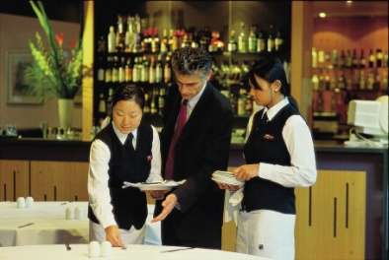
Develop human resources plan
Contents of a HR plan
Organisational business plan
HR Planning
HR Information management
Identify staffing needs
Work design / classification
Notes:
Class Activity – General discussion & Review HR Plan
What information is included in each section
Trainer to show a copy of a HR plan to the audience and summarise the content.

Slide 24

Develop human resources plan
Contents of an HR plan
Recruitment and selection
Learning and development
Performance management
Monitoring and evaluation
Notes:
Class Activity – General discussion & Review HR Plan
What information is included in each section
Trainer to show a copy of a HR plan to the audience and summarise the content.

Slide 25

Implement human resources plan
Steps in implementing a HR plan
Implement a human resources plan may include:
Communication and explanation of the human resources plan to relevant personnel
Practical application and implementation of the strategies outlined in the plans
Support to individual department and individuals in plan implementation and execution
Notes:
Class Activity – General discussion
Discuss each of these steps
Why are these essential?
What needs to be prepared / activities undertaken for each of these steps?

Slide 26

Implement human resources plan
Steps in implementing a HR plan
Monitoring actual outcomes and evaluating them against projections
Taking remedial action to bring plans back in-line with objectives
Development of job specifications and job descriptions
Notes:
Class Activity – General discussion
Discuss each of these steps
Why are these essential?
What needs to be prepared / activities undertaken for each of these steps?

Slide 27

Job specifications
Details the human qualities required for the position
Title of the job
Minimum level of education
Specialised training required
Work-related experience
Personal attributes required
Physical effort required to do the job
Interpersonal skills required
Notes:
Class Activity – General discussion & Review Document
Why are JS important?
Trainer to show and explain document to audience.

Slide 28
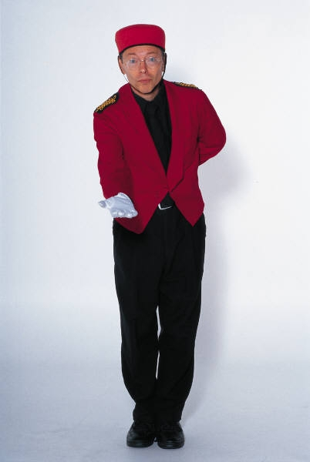
Job descriptions
Information about what the job is all about
Job title
Location of the job
Job responsibilities
Day-to-day tasks of the position
Job title the position reports to
Number of people supervised by the position
Notes:
Class Activity – General discussion & Review Document
Trainer to show different JD’s for different positions and explain document to audience.

Slide 29

Job descriptions
Working conditions
Workplace hazards
Special work procedures to be followed
Equipment, technology, systems used in the job
Output standards required
Type of work measurement used for the work performed
Notes:
Class Activity – General discussion & Review Document
Trainer to show different JD’s for different positions and explain document to audience.

Slide 30

Element 2:
Develop and administer human resource policies and procedures
Notes:
Introduce topic.
Class Activity – General Discussion
Ask general questions:
What is a policy and procedure?
What are examples of HR policies and procedures?
How are they documented?
How are they communicated to staff?

Slide 31

Develop and administer human resource policies and procedures
Performance Criteria for this Element are:
Research and document enterprise needs in relation to human resource performance
Develop and document organizational disciplinary policies and procedures
Develop and document organizational issue resolution and grievance policies and procedures
Notes:
Trainer identifies the Performance Criteria for this Element, as listed on the slide.

Slide 32

Develop and administer human resource policies and procedures
Performance Criteria for this Element are:
Develop and document human resource manual to guide and govern day-to-day human resource practice
Distribute and explain organizational human resource policies and procedures
Notes:
Trainer identifies the Performance Criteria for this Element, as listed on the slide.

Slide 33

Document enterprise human resources needs
Importance of documenting needs
Given that the Human Resources Department is often responsible for the hiring and development of staff it is only natural that they will take a proactive role in either establishing or documenting and controlling:
Staff performance expectations
Standard operating procedures
Other staffing related matters
Notes:
Class Activity – Discussion
What should be documented under each of these points?

Slide 34

Performance standards
Every job has standards of performance that are required to be met by the employee undertaking that job
Performance standards are specific targets of what a staff member must achieve
What are examples of performance standards?
Notes:
Class Activity – Questions
What are examples of performance standards for the following job roles:
Waiter
Chef
Reservationist
Receptionist
Porter
Room attendant

Slide 35

Performance standards
Examples of performance standards
The waiting time before presentation of the menu
The number of tables to be covered
How a room should be cleaned
Time taken to set up
Deadlines for reports
Turnover targets
Notes:
Class Activity – Questions
Where do performance standards come from?
Who sets them?
What is the importance of having a performance standard?

Slide 36

Performance standards
Where do performance standards come from?
Performance standard represent the level of performance and behaviour necessary for the job to be done successfully and are derived from:
Personal observation of actual practice
Past performance records
Notes:
Class Activity – Questions
How can you determining performance standards from each of these points?
What other ways can you determine performance standards?

Slide 37

Performance standards
Where do performance standards come from?
Time-work studies
Production and technical information
Industry standards
Consultation with employees
Benchmarking (best practice)
Notes:
Class Activity – Questions
How can you determining performance standards from each of these points?
What other ways can you determine performance standards?

Slide 38

Performance standards
Documentation of performance standards
Standards of performance can be documented in either:
A job description
An employment contract
Company policy documents
Induction and orientation
Notes:
Class Activity – Discussion and review
Trainer explain point in more detail (see below) and hand out actual examples of these documents highlighting the performance standards.
A job description - a detailed breakdown of the responsibilities and tasks within a job
An employment contract - specifically for management positions
Company policy documents – including policies, procedures and SOPs
Induction and orientation - It is essential that upon commencement, the employee is informed and acknowledges they understand the requirements of their job.

Slide 39
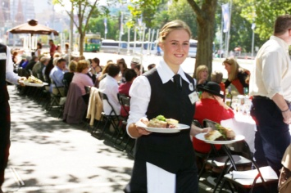
Types of performance standards
Productivity
Punctuality
Personal presentation
Level of accuracy in work performed
Adherence to procedures
Customer service standards
Team interaction
Response times/waiting times
Notes:
Class Activity – Questions
What other performance standards could you develop for these areas?

Slide 40

Job behaviour standards
As well as having performance standards for the various jobs, an organisation will also have job behaviour standards for employees.
These include:
Initiative
Motivation
Attitude
Notes:
Class Activity – Questions
What other job behavior standards could you develop for staff?
What specific standards could be put in place?

Slide 41

Job behaviour standards
Punctuality
Dependability
Appearance
Communication skills
Teamwork
Notes:
Class Activity – Questions
What other job behavior standards could you develop for staff?
What specific standards could be put in place?

Slide 42

Preparing SOP’s
Standard Operating Procedures (SOP) – standard instructions indicating how to perform specific tasks and the order of sequence
Policies – rules to follow in an organisation relating to difference circumstances
Procedures – step by step instruction detailing how to complete an activity
Daily Task Sheets
Notes:
Class Activity – Show documents
Trainer to show examples of these documents

Slide 43

Preparing documents
Who prepares the documents?
The documents may be prepared or incorporate the involvement of three main areas:
Head office
Human Resources
Departmental or outlet managers
Notes:
Class Activity – Questions
Head office – they will have templates which are used company-wide to ensure consistency
Human Resources – they have the ability to prepare necessary documents, resources (access to job descriptions and specifications) and specific knowledge to ensure the format meets the requirements of the specific hotel and chain.
Departmental or outlet managers – they have a sound understanding of what the individual tasks their staff do as part of their job role

Slide 44

Communicating documents
Methods of communicating the standards
As part of the induction and orientation
During mandatory in-house training programs
During staff meetings, briefings and de-briefings
On posters throughout the workplace
On the intranet
Notes:
Class Activity – Questions
Which method do you believe to be the most effective and why?

Slide 45

Disciplinary policies and procedures
Develop and document organisational disciplinary policies and procedures
Disciplinary action will need to be considered whenever a staff member, regardless of position or rank violates establishment policies
Disciplinary policies and procedures are enforced by HR departments in the event of a breach by an employee
Notes:
Class Activity – Explanation
Why are these forms important?
What information is contained within these?

Slide 46

Disciplinary policies and procedures
What is the difference between counselling and discipline?
Workplace counselling:
Concerned with discussions and analysis of personal and work problems that affect an employee’s work performance in an attempt to find a solution
Discipline:
Direct statement of what is wrong and a directive to improve – a warning
Notes:
Class Activity – Explanation
What policies and procedures should be introduced for these?
Which one comes first and why?

Slide 47

Disciplinary policies and procedures
Steps in an effective counselling session
Prepare for the session
Develop an opening statement
Get agreement to fix the problem
Explore reasons
Reconfirm the problem
Generate and chose a solution
Prepare an Action plan and review date
Notes:
Class Activity – Explanation
Why is counselling important.
Discuss these steps.

Slide 48

Disciplinary policies and procedures
Types of actions requiring discipline
Intoxication or drug use while on the job
Theft of company property
Physical and/or verbal assault of another staff member
Sexual harassment
poor performance
Poor attendance
Tardiness behaviour
Notes:
Class Activity –Discussion
What should happen in each of these instances?

Slide 49

Disciplinary policies and procedures
Disciplinary actions
Verbal Warning
Written Warning
Investigation
Termination
Notes:
Class Activity – Explanation
What are the steps associated with each?

Slide 50
Grievance policies and procedures
In any organisation, issues and grievances are common place.
It is the role of Human Resources to keep up to date and well versed in:
Any existing legislation in this matter
Terms and conditions of the award or agreement that is in effect
Policies and procedures designed for the establishment
Notes:
Class Activity – Explanation
Why is this important?
How can you obtain information to keep up to date?

Slide 51

Grievance policies and procedures
Handling grievances
What is a grievance?
What normally causes them?
How can you identify them?
How should they be handled?
Notes:
Class Activity – Explanation

Slide 52

Grievance policies and procedures
Understand relevant legislation
Awards
An award is a legally binding document, for both the employer and the employees, containing a set of working conditions that apply to all businesses and employees covered by it:
What awards or laws apply?
What do they state in relation to handling grievances?
Notes:
Class Activity – Review of awards and other legislation
Trainer to show and explain different awards or appropriate legislation.

Slide 53

Grievance policies and procedures
General dispute and grievance procedures
Arranging meetings to discuss the issue
Being available to meet with the workers
Making staff aware of where their award/agreement
Explaining relevant parts of the award/agreement a
Referring to the relevant websites
Facilitating meetings with management
Representing the issue raised by workers to management
Notes:
Class Activity – Discussion
Discuss these procedures.

Slide 54

Human resources manual
Importance of Human Resources Manual
One of the key documents that is used by the human resources department to notify staff of general standards and expectations is a manual:
What information should be included in a manual?
How and when should it be communication with staff?
Notes:
Class Activity – Discussion
Discuss questions in the slide

Slide 55

Human resources manual
Contents of Human Resources Manual
Uniform and personal appearance
Meals and rest breaks, including rosters, holidays/leave entitlements
Time sheets/clocks and the authorization of overtime, including notification of absence and sickness provisions
Use of company equipment, facilities and services
Confidentiality and privacy, including commercial in confidence material
Notes:
Class Activity – Discussion & Review document
Trainer to show and explain a Human Resources Manual

Slide 56

Human resources manual
Contents of Human Resources Manual
Personal performance, including performance assessments, standards and reviews
Training and promotions
Discipline and issue resolution
Workplace health and safety
Responsibilities
Organizational structure & hierarchy
Notes:
Class Activity – Discussion & Review document
Trainer to show and explain a Human Resources Manual

Slide 57

Human resources manual
Importance of policies and procedures
What is the different between a policy and procedure?
How decides them?
Where do they come from?
In which areas should policies and procedures be developed?
Notes:
Class Activity – Discussion
Discuss the questions in the slide.

Slide 58
Human resources policies and procedures
Areas for policies and procedures
Job advertising
Internal promotion of staff
Staff training
Remuneration
Probationary period
Terms and conditions of employment
Benefits
Notes:
Class Activity – Discussion
What are examples of policies and procedures that may be introduced for each of these areas?

Slide 59

Human resources policies and procedures
Areas for policies and procedures
General staff behaviour and presentation
Interview and selection panels
Designated authorities for hiring staff
Discretionary power
Legislation
Notes:
Class Activity – Discussion
What are examples of policies and procedures that may be introduced for each of these areas?

Slide 60

Element 3:
Organize human resources
Notes:
Introduce topic.
Class Activity – General Discussion
Ask general questions:
What are the different activities that need to be performed by Human Resources?

Slide 61

Organize human resources
Performance Criteria for this Element are:
Participate in staff selection
Develop staff induction programs
Organize work programs
Develop teams to support work
Provide for supervision of staff
Notes:
Trainer identifies the Performance Criteria for this Element, as listed on the slide.

Slide 62

Staff selection
Participate in staff selection
One of the key roles of human resources is to recruit new staff for an organisation.
There are many steps associated with this process before a new staff members starts their first day of employment
What is involved in this process?
Notes:
Class Activity – Discussion
Discuss the staff selection process.

Slide 63

Develop key selection criteria
Will address:
Competencies
Experience
Qualifications
Compatibility
Form the basis of ‘Interview Rating Sheets
Notes:
Class Activity – Discussion & Review Document
Trainer to show examples of these documents
Trainer to prepare a list a job titles and get audience to develop a ‘key selection criteria’ for that position

Slide 64

Obtain authority to recruit staff
Need to obtain authority
In what areas would you need authority?
When would you need to obtain authority?
Who provides this authority?
How can authority be obtained?
What areas require authority?
Notes:
Class Activity – Discussion
Discuss the questions in the slide about obtaining authority

Slide 65

Identify sources of staff
Sources of staff
Media advertisements
Job agencies and recruitment agencies
Internet recruitment
Internal advertising
Schools and trade colleges
Industry network contacts
Other staff
Considering people who have already registered with you
Participating in career fairs
Notes:
Class Activity – Discussion
When would each of these sources be appropriate?
What are the advantages of each?
What are the disadvantages of each?

Slide 66

Develop and lodge job advertisements
What needs to be considered when preparing:
Producing media advertisements
Providing information to recruitment agencies
Notes:
Trainer highlights for trainees points to consider when writing a job advertisement include:
Business name and contact details – check with the business first however because some establishments prefer not to advertise their name as it can cause too many calls to be made to the premises.
Businesses may want to include the address and telephone number – or there may be a requirement not to do so.
Job title and job description – providing a brief outline of the tasks required to be carried out. This may need to be highlighted as it is often the element of the advertisement that attracts the attention of potential applicants.
Description of the ideal applicant – this must be based on the job description and detail experience, skills, personal qualities and qualifications. It is important this is an accurate and honest depiction of what is required as it enables the advertisement itself to screen out inappropriate applicants

Slide 67

Develop and lodge job advertisements
What needs to be considered when:
Producing media advertisements
Providing information to recruitment agencies
Notes:
Class Activity – Handouts
Trainer assembles a wide range of newspaper job vacancy advertisements relevant to the trainee cohort and:
Distributes and discusses them
Asks trainees to evaluate them from the point of view of a person seeking employment:
How good or bad are they?
Do they provide enough information?
What extra information should have been included?
Which adverts seem most effective and why?
Highlights the media used
Examines the days of the week the advertisements are lodged.

Slide 68
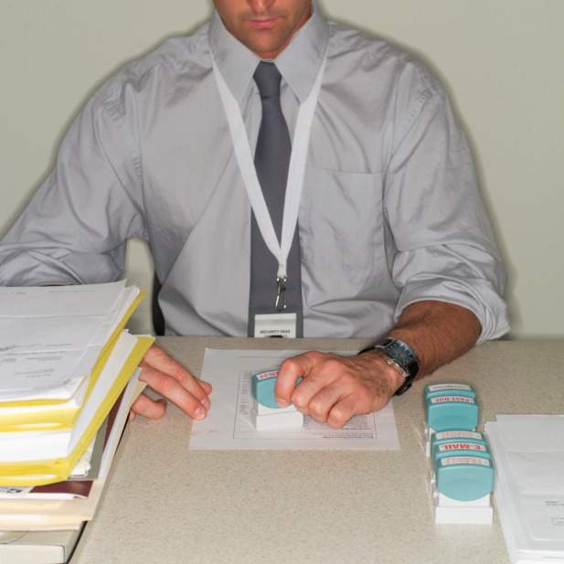
Accept job applications
Expect applications immediately
Expect calls and queries from job-seekers and recruitment agencies
Accept and file the applications
Unsuitable applicants can be rejected at this stage
A ‘Letter of Thanks and Regret’ should be sent
Some businesses also return applicant’s CV
Some businesses retain all applications
Notes:
Class Activity – Discussion
Discuss the importance of these steps

Slide 69
Short-list applicants
Process of developing a list of applicants who will proceed through to the interview stage of the selection process:
Determining who will be short-listed may involve:
Reading ‘Covering letter’ of application
Brief reading of CV
Brief reading of application form
Advising them of interview
Sending letters to unsuccessful persons
Notes:
Class Activity – Discussion
Discuss the importance of these steps

Slide 70

Check references and referees
Need to check:
References
Referees
Statement of Employment
Notes:
Class Activity – Handouts
Trainer obtains a selection of references (with names of people blocked out) and:
Distributes them to trainees to read
Asks trainees their opinions about them – what do the references tell them about the person?
Points to the fact there is never a bad reference – they are all written in glowing terms.

Slide 71

Notify applicant of interview
Notifying an applicant about an interview should address:
Date and time
Location
What they should bring with them
Duration of interview
Interview format
Notes:
Class Activity – Discussion
How can you notify the person?
What do people need to bring to an interview?
What other information may be helpful?

Slide 72

Conduct job interview
Planning and preparation
Booking room for interviews
Determining duration of interviews
Scheduling interviews with applicants
Identifying who will conduct the interviews
Pre-reading and digesting all appropriate résumés
Determine necessary protocols, roles and responsibilities in the interviews
Arranging catering
Notes:
Class Activity – Discussion
Discuss the importance of these steps

Slide 73
Conduct job interview
Basic interview formats:
One-on-one interviews
Panel interview
Group interview
Telephone interview
Notes:
Class Activity – Discussion
When would each of these formats be most appropriate?

Slide 74

Conduct job interview
Before interviews staff involved must ensure:
Applicants have been notified and advised about what to bring
Applications have been read
Job Description and Specification have been read
KSC have been read
An appropriate interview location is ready
Interviewee roles have been clarified
Notes:
Class Activity – Guest Speaker
Trainer arranges for a suitable HR manager (or similar) to attend and:
Discuss their views on interviewing applications for vacancies
Present details of the planning and preparation they do prior to an interview
Provide examples of documentation they use related to interviews
Give opinions and tips on effective interview techniques.

Slide 75

Conduct job interview
What should you do?
Start of the interview
Middle or main part of interview
End of interview
Notes:
Class Activity – Demonstration (Mock interview)
Trainer arranges for experienced people (from the Training Institute or an industry workplace) to:
Attend class
Describe a job they will be interviewing for
Arrange the room as required – explaining why this is being done the way it is
Show/explain any prepared questions or documentation to be used throughout the demonstration
Conduct the interview – welcoming the ‘interviewee’, asking planned questions and follow-up questions, demonstrating techniques they apply when interviewing staff
De-brief after the mock interview – explaining what they did and why they did it
Answer questions from trainees.
Trainer may elect to video-tape the mock interview for later analysis.

Slide 76

Apply relevant testing procedures
Testing is done to:
Determine competency levels
Prove health of the applicant
Identify drugs or alcohol
‘Profile’ the person
Notes:
Class Activity – Discussion
What are common tests that are undertaken in a hospitality environment?
What is the purpose for the test?

Slide 77
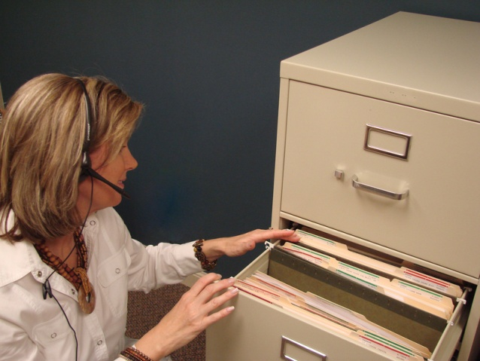
File application and interview documentation
Filing activities
File documents
Detail all ‘Thanks and Regret’ letters sent
Forward all applications that 'just missed out' to Personnel or various department heads
Photocopy and forward documents of successful applicants to HRD
Notify departments as necessary regarding employment of a new person
Notes:
Class Activity – Discussion
Why is it important to file all interview documents?

Slide 78

Choose successful applicant
Selecting the successful applicant
Comparing the applicant with the job analysis, description and specification
Reviewing the interview
Consider impressions and opinions
Rating the applicants into priority order using ‘Interview Rating Sheet’
Determining if an offer should be made
Notes:
Class Activity – Show ‘Interview Rating Sheet’
Review document.
What should be in the document?

Slide 79

Notify successful applicants and make formal job offer
When the successful candidate has been selected they must be advised of this:
A telephone call is the usual method
A formal ‘Letter of Offer/Appointment’ should also be provided
All enterprise policies and procedures must be complied with
Notes:
Class Activity – Discussion
What should be included in a ‘Letter of Offer / Appointment’?

Slide 80
Notify successful applicants and make formal job offer
The Letter of Appointment
Remuneration details
Advice regarding legislated obligations
Short-form job description
Brief description of main duties
Date offer is valid to
Action needed to accept the offer
Notes:
Class Activity – Handout
Trainer obtains sample Letter of Appointment or draft work contract and:
Distributes to trainees
Discusses the contents of the document
Explains why each statement is provided.

Slide 81

Notify successful applicants and make formal job offer
The Letter of Appointment
Start date and time
Start location
Name of award they are being employed under
Job classification and employment status
Details of probationary period
Leave entitlements
Specified hours of work
Notes:
Class Activity – Handout
Trainer obtains sample Letter of Appointment or draft work contract and:
Distributes to trainees
Discusses the contents of the document
Explains why each statement is provided.

Slide 82

Notify unsuccessful applicants
Most common method of advising unsuccessful candidates is by sending a Letter of Thanks and Regret:
Date
Thanks
Name of position applied for
Statement they have been unsuccessful
Encouragement statements
Notes:
Class Activity – Discussion
Why is it important to notify unsuccessful applicants?

Slide 83

Follow-up as required
After an offer has been made to an applicant you may need to follow-up to:
Obtain originals of documents
Explain details of the offer
Confirm offer has been received
Offer a rejected offer to another applicant
Notes:
Class Activity – Discussion
What activities are associated with each?

Slide 84

Plan the induction session
Considerations
Timing
Familiar face
OHS considerations
Materials
Location
Notes:
Class Activity – Discussion
What are other considerations?
What needs to be planned for an induction program?

Slide 85

Plan the induction
Formal induction and orientation sessions must address:
Completion of necessary paperwork
‘Need to know’ information
Tour of the workplace
Meeting with management, supervisors and co-workers
Allocation of uniform
Notes:
Class Activity – Handouts
Trainer obtains sample documentation as identified on this slide and:
Distributes to trainees
Discusses and explains their role
Tells trainees where these forms may be obtained.

Slide 86

Plan the induction
Detailed department and position induction
Expectations of the role
Coverage of job description
Copy of roster
Enterprise-based terminology, acronyms and abbreviations
Explanation of the operation of the business
Notes:
Class Activity – Handouts
Refer to handouts in Slide 85

Slide 87

Plan the induction
Safety and security issues
Company benefits
Workplace awards
Performance appraisals
Allocation of a ‘buddy’
Notes:
Class Activity – Handouts
Refer to handouts in Slide 85

Slide 88

Conduct the induction session
When conducting an induction and orientation session:
You only have once chance to make a positive impression
Arrive early – never keep new staff waiting
Welcome them
Express appropriate sentiments
Notes:
Class Activity – Excursion
Trainer arranges for trainees to visit a local enterprise and:
Talk to management about staff recruitment, selection and induction and orientation sessions
View management offices where they work and see the facilities they have to work with
View relevant management policies and procedures related to staffing functions
Observe a hiring interview – if possible (or a mock interview)
Participate in a mock induction and orientation session.

Slide 89

Conduct the induction session
Explain what orientation will cover
Tell them how long it will take
Encourage questions
Stick to the plan for the session
Be flexible
Focus on the new employee
Do not rush
Do not drown the employee with information
Notes:
Class Activity – Excursion
Refer to excursion on Slide 88

Slide 90
Conduct the induction session
Provide personal insight
Try to ensure privacy
Answer all questions asked by new employee
Read through important documents with them
Avoid ‘group’ inductions
Facilitate integration of new employee with existing structures and workforce
Seek feedback on the induction and orientation
Notes:
Class Activity – Excursion
Refer to excursion on Slide 88

Slide 91

Organise work programs
Types of work programs
Work programs may include:
Identification of workloads and work flows for each job
Identification of legal and safety issues that apply
Description of relevant service standards
Allocation of necessary materials, safety equipment and resources to enable role completion
Benchmarking of work and standards
Employer expectations
Notes:
Class Activity – Discussion & Show work program documents
Why are work programs important?
Why have them?
What should they cover

Slide 92

Organise work programs
Organisational requirements
Legal and organisational policy and procedures, including personnel practices and guidelines
Organisational goals, objectives, plans, systems and processes
legislation relevant to the operation, incident and/or response
Employer and employee rights and responsibilities
Notes:
Discussion and review of documents
What is the impact of these organisational requirements when identifying group and individual roles and responsibilities?
Trainer to provide examples of these documents and discuss their impact on identifying roles.

Slide 93

Organise work programs
Organisational requirements
Business and performance plans
Key Performance Indicators
Policies and procedures relating to own role, responsibility and delegation
Quality and continuous improvement processes and standards
Client service standards defined resource parameters
Notes:
Discussion and review of documents
What is the impact of these organisational requirements when identifying group and individual roles and responsibilities?
Trainer to provide examples of these documents and discuss their impact on identifying roles.

Slide 94

Organise work programs
What to plan for
Any aspect of work operations can be planned including:
The procedures or systems that exist
The workflow
Gaps or overlaps in service provision
The workload of staff
The time it takes to do a task or job
The job design of individual staff
The level of customer satisfaction
Notes:
Class Activity – Discussion
What else would you plan for?

Slide 95

Identify tasks to be completed
Ways to identify what needs to be done
Personal experience
Bookings/reservations
Directives from management
Day-to-day workplace problems
Knowledge of external factors impacting on the business
Personal observation of what staff are doing or not doing
Feedback from staff, customers and supervisors
Notes:
Class Activity – General discussion
Discuss from personal experiences.
Which ways are the most effective and why?

Slide 96

Develop teams
Develop teams to support work
What is a team?
What types of teams are there in a hospitality environment?
What influences teams?
What are the characteristics of effective teams?
How can managers develop teams?
Notes:
Class Activity – General discussion
Discuss the questions in the slide.

Slide 97

Prioritise work activities
Prioritising your tasks means that you will have to determine which tasks are the:
Most important and should be done first
Which ones can be left until later
Notes:
Class Activity – General discussion
In your past experience:
What work activities to you need to do on a daily basis?
How do you prioritise your work activities?
Are you good at managing your time?
If so, how do you do it?
If not, why not and how could you be better are it?
Do you procrastinate? Why?

Slide 98

Prioritising work
Steps in prioritising work
The four basic steps in prioritising work are:
Involve staff in the process wherever possible
Make three lists:
Essential tasks
Non-essential tasks that add quality
Non-essential tasks that would be nice to do
Notes:
Class Activity – Activity on prioritising work
Trainer to get the audience to pick a position.
They are to list a range of tasks that need to be completed
They should decide on a priority order for task completion explaining the reasoning behind the order

Slide 99

Prioritising work
Steps in prioritising work
Compare the lists you have generated with the overall goals and objectives of the unit
Adjust the lists accordingly, allocate the work and take action to achieve the lists in priority order
Notes:
Class Activity – Activity on prioritising work
Activity extends on from last slide

Slide 100

Organising workflow
Workflow is basically the order in which work is best done
Organising this involves determining the logical sequence of tasks
The aim is to make sure the job is done efficiently and effectively
Notes:
Class Activity – Questions
How can you organise workflow?

Slide 101

Organising workflow
Things to take into account when organising workflow include:
How long each individual task should take
Recognition of staff needs and award requirements such as breaks
The number of people to best achieve a result or task
Occupational health and safety requirements
The most logical order of tasks to avoid duplication and gaps in service
The suggestions of staff who are actually doing the job
Notes:
Class Activity – Discuss points
Discuss points on organising workflow

Slide 102

Delegate work to staff
In this workplace context, delegation has two meanings:
It can mean the allocating of tasks to staff that are part of their normal duties
It can also mean allocating some of your own duties to staff who are willing to take these on
Notes:
Class Activity – Questions
What is delegation?
Why is it beneficial?
What duties can a manager delegate to staff to perform?
What can they not delegate? Why?

Slide 103
Delegate work to staff
Delegating tasks to staff that are part of their duties
Be clear about the task to be done
Explain why the task has to be done and in a certain way
Choose an appropriate time to inform and explain delegation
Provide whatever instructions are necessary in the correct sequence, explaining all of the steps
Notes:
Class Activity – Discuss points
Discuss the steps associated with delegating tasks as part of their duties.
Make sure you are clear about the task to be done – if you don’t know what you want done how can you expect to convey this to someone else?
If appropriate, explain why the task has to be done, and why it has to be done in the way you are specifying – clear communication is critical
Choose an appropriate time to inform the staff member about the delegation, and don’t hurry the explanation
Provide whatever instructions are necessary in the correct sequence, explaining all of the steps

Slide 104

Delegate work to staff
Delegating tasks to staff that are part of their duties
Provide training and demonstration
Continually encourage and check if the employee has any questions
Check their understanding
Give them positive feedback
Notes:
Class Activity – Discuss points
Discuss the steps associated with delegating tasks as part of their duties.
Provide training and demonstration, as required
Continually check if the employee has any questions and encourage them to ask questions – ensure your replies underline you expect and encourage questions
Continually check the staff member genuinely understands what is being said and shown to them – you may ask them questions or get them to demonstrate what is required
Give them positive feedback – people operate better from a platform level of optimism and success, so make them positive and confident.

Slide 105

Clarify work allocation
The allocation of tasks can vary based on issues such as:
Expected demand
Nature of specific events
VIP’s
Staff absences
Customer/guest feedback
Equipment problems
Unexpected events
Emergencies
Special requests
Notes:
Discussion
How will these affect the allocation of work?
How do you notify staff of these task allocations?

Slide 106

Communicate information to team members
Whilst communication and information may primarily come from managers, it is important to remember that all colleagues within a team will communicate and share information on a daily basis:
What information do team members need?
What is the best way to communicate this information?
Notes:
Class Activity – Discussion
Discuss the questions in the slide.

Slide 107

Supporting team members
Supporting team members
Giving moral and verbal support
Providing relevant training/coaching
Obtaining more physical resources
Getting approval for more time
Advocating to management on behalf of the staff
Supporting staff
Soliciting and listening to their feedback
Thanking them
Notes:
Class Activity – Discussion
Why is it important to support staff?
What other types of support can be provided?

Slide 108
Monitor and control operations
Any aspect of work operations can be monitored with a view to improvement including:
The procedures or systems
The workflow
Gaps or overlaps in service provision
The workload of staff
The time it takes to do a task or job
Job design
Level of customer satisfaction
Notes:
Class Activity – Questions
What would you like to know when monitoring these areas?
How can they be monitored?
Who will do the monitoring?

Slide 109
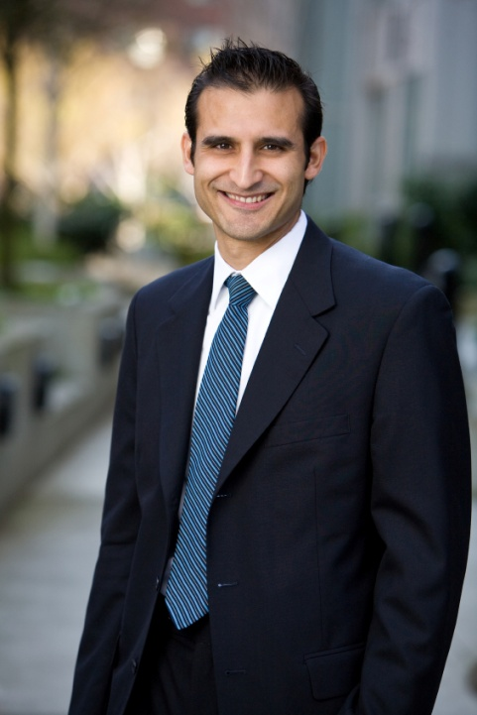
Element 4:
Lead and motivate staff
Notes:
Introduce topic.
Class Activity – General Discussion
Ask general questions:
How do you lead people?
What are characteristics of leaders?
How is leadership different to management?
How can you motivate staff?

Slide 110

Lead and motivate staff
Performance Criteria for this Element are:
Set goals to optimize work achievement
Advise and support staff in their work
Encourage and recognize initiative, effort and contribution from staff
Notes:
Trainer identifies the Performance Criteria for this Element, as listed on the slide.

Slide 111

Setting plans and goals
Importance of planning
What is the purpose of planning?
Who prepares plans?
What types of plans are there?
What is the difference between goals, strategies and tactics?
What does SMART mean when setting goals?
How do you communicate plans and goals with staff?
Notes:
Class Activity –Discussion
Discuss the questions in the slide.

Slide 112

Setting plans and goals
Format of plans
Detail of the action to be taken
Resources available
Allocation of work
Timelines that apply
KPIs
Notes:
Class Activity – Explanation and Review of plans
What other information can be included in plans?
Trainer to show and explain common plans to audience.

Slide 113

Guidance and support
Managers need to guide and support staff in relation to their performance.
For guidance and support to be effective it needs to be:
Be seen as a positive experience
Provided when needed in a timely manner
Tailor-made to suit the needs of the individual
Provided willingly
Aligned with promises made about support and guidance
Notes:
Class Activity –Questions
How can you provide guidance and support?
How can you make guidance and support a positive experience?

Slide 114

Guidance and support
Examples of guidance and support
Provision of top-up training
Provision of demonstrations to show what is required
Advice on training and development opportunities which exist
Support with difficult interpersonal/personal situations
Notes:
Class Activity –Questions
Discuss the action involved in the points mentioned in this slide

Slide 115

Guidance and support
Examples of guidance and support
Provision of opportunities to discuss work challenges
Provision on confirmation of organisational objectives and key performance objectives
Ensuring adequate resources are applied to identify staff performance needs
Representation of staff interests in other forums
Notes:
Class Activity –Questions
Discuss the action involved in the points mentioned in this slide
Provision of opportunities to discuss work challenges – which can include staff meetings and briefings as well as having an ‘open door’ policy towards staff issues. Some properties may establish ‘toolbox’ meetings where staff meet and discuss work issues together
Provision on confirmation of organisational objectives and key performance objectives – which can include provision of updates, clarification of relevant points and explanation of ‘issues arising’
Ensuring adequate resources are applied to identify staff performance needs – the venue must provide whatever resources were promised and must make sure they are available when needed. Resources can include physical resources, knowledge, time, staffing and money
Representation of staff interests in other forums – this includes taking staff issues to senior management/business owners and acting as their advocate in this context. This can also include speaking on behalf of staff when complaints arrive from customers

Slide 116

Recognition and rewards
Considerations
Who is entitled to rewards
The type of reward
The size of the reward
Authorisations that have to be obtained before the reward can be given
Notes:
Class Activity –Questions
What are some common guidelines you would implement for issuing rewards, taking into account considerations stated on this slide?

Slide 117

Recognition and rewards
Considerations
Limitation to rewards
Time-frames that may apply to the application of rewards
Documentation which needs to be completed when issuing a reward
Proof needed to support the granting of rewards
Notes:
Class Activity –Questions
What are some common guidelines you would implement for issuing rewards, taking into account considerations stated on this slide?

Slide 118

Recognition and rewards
Determining rewards that matches motivational needs
When determining which reward option to select for a particular staff member there are two important factors to take into account:
Compliance with property policy and guidelines
Matching the reward to the individual preferences of the staff member
Notes:
Class Activity –Questions
How can you understand individual preferences of staff members?

Slide 119

Recognition and reward options
Types of recognition and rewards
Verbal praise
Certificates and letters
Free products and services
Promotions
Time off
Encouraging attendance at events
Promoting industry nomination
Notes:
Class Activity –Questions
Do these reward suit you?
Which of these rewards listed on this slide would you prefer over others?
If not, what would you prefer?

Slide 120

Element 5:
Develop human resource performance
Notes:
Introduce topic.
Class Activity – General Discussion
Ask general questions:
How can you develop performance?
How do you assess performance?

Slide 121
Develop human resource performance
Performance Criteria for this Element are:
Develop staff appraisal system
Notify staff in regard to implementation of internal staff appraisals
Implement staff appraisals in-line with established protocols
Support staff as a result of staff appraisals
Notes:
Trainer identifies the Performance Criteria for this Element, as listed on the slide.

Slide 122

Performance appraisals
Performance assessment
Assessing a person’s performance based on a range of performance indicators
It has looked at WHAT the person is actually doing
Performance appraisal
Performance appraisal is the process of evaluating and developing the work performance of employees so organisational goals and objectives are achieved
Notes:
Class Activity –Discussion
Trainer to discuss the differences between these two activities

Slide 123

Performance appraisals
Performance appraisal
This involves the manager and the staff member and discussing the performance assessment including:
Identify and discuss aspects of performance, both positive and negative
Understand why performance is conducted a specific way
Identify causes for performance not meeting standard
Discuss and identify how performance can be improved
Notes:
Class Activity – Questions
Why are these aims important?

Slide 124

Purpose of performance appraisals
There are many reasons why formal performance appraisals are undertaken in organisations:
To improve and maintain performance
To correct performance deficits
To reward, recognise and compensate
To strengthen relationships between supervisor and subordinates
To share information
Notes:
Class Activity – Discussion
Discuss why these reasons are important. (see answers below)
There are many reasons why formal performance appraisals are undertaken in organisations:
To improve and maintain performance
To correct performance deficits
To reward, recognise and compensate
To strengthen relationships between supervisor and subordinates – performance appraisals are a good way for the manager and subordinate to discuss issues concerning work. If done correctly, it should mean the subordinate and the supervisor have a better understanding of each other’s position
To share information – by giving information to employees and getting feedback from employees on methods and processes. By getting feedback, the manager might be able to improve processes

Slide 125

Benefits of performance appraisals
Performance appraisals should benefit:
The organisation’s effectiveness
The supervisor/manager
The employee and their family
The customer
Suppliers
Notes:
Class Activity –Questions
How do performance appraisals benefit each of the groups mentioned in this slide?

Slide 126

Preparing performance appraisals
The steps involved in preparing performance appraisals
Review performance assessment documents
Ensure you have all the facts
Plan how you will present positive and negative news
Consider what may have impacted on the employee’s performance both negatively and positively
Have an outline of what you want to say and how you want to say it
Notes:
Class Activity –Discussion
Discuss why each step is important and the actual activities associated with each step

Slide 127

Preparing performance appraisals
The steps involved in preparing performance appraisals
Prepare staff appraisal documents
Schedule staff appraisals
Notify staff of appraisal times
Issue staff appraisal documents
Arrange a suitable environment, free from interruptions and ensures privacy and confidentiality of discussions
Prepare appraisal area including catering
Notes:
Class Activity –Discussion
Discuss why each step is important and the actual activities associated with each step

Slide 128

Performance appraisals forms
Forms may be used when conducting a performance appraisal, either as the primary document or to supplement specific appraisal documents.
Regardless of the documents used it is important that two parties are active in the appraisal process:
The person conducting the appraisal
The person being appraised
As such, a document should be prepared which will be completed by both parties
Notes:
Class Activity –Discussion
What documents can you use?
Why is it important for both parties to complete?

Slide 129

Performance appraisals forms
Types of performance appraisal forms
There are two main performance appraisal forms that can be used. These are for:
Appraisal of staff
Appraisal of managers
The structure and marking criteria of each form is different to reflect the nature of their job role.
Notes:
Class Activity –Discussion
How would these differ?

Slide 130
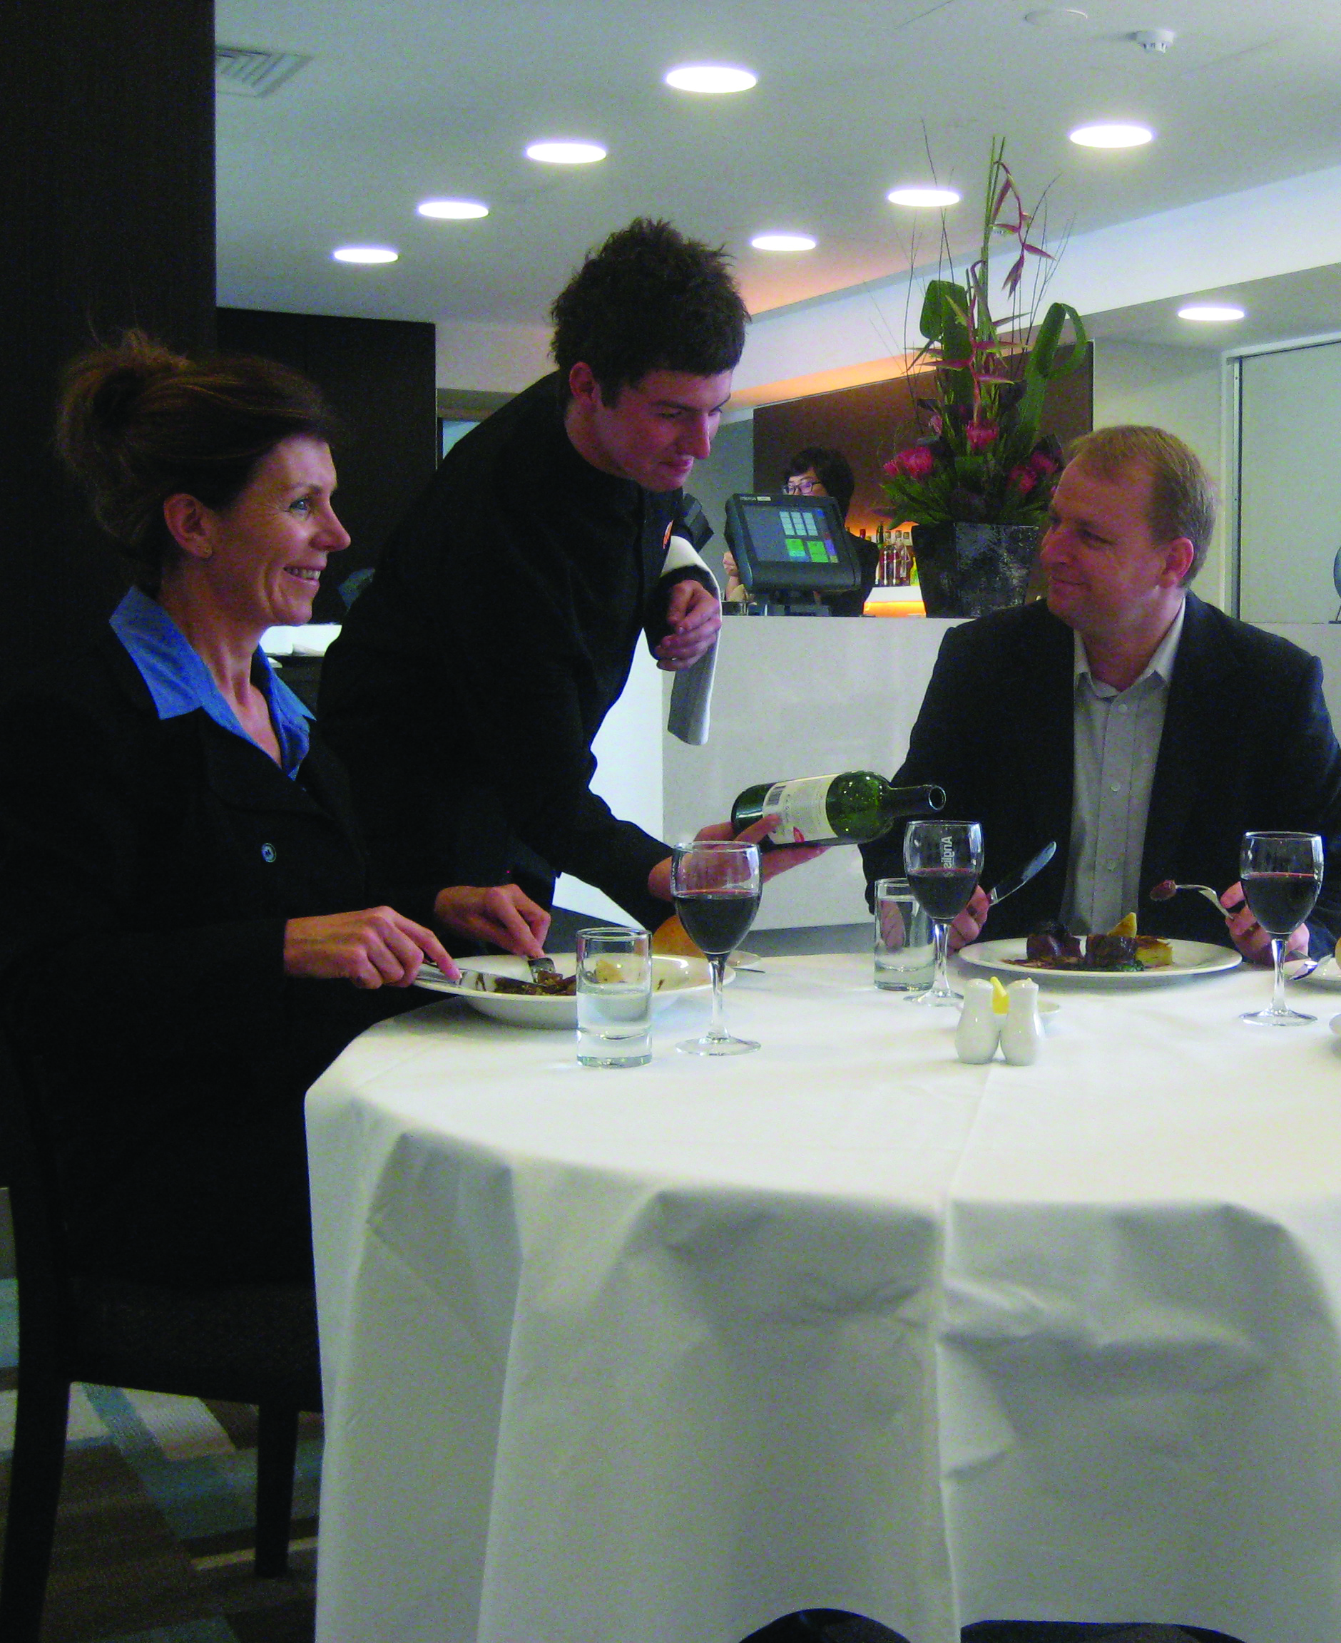
Performance appraisals forms
Staff appraisal format
Staff are traditionally employed to complete specific tasks and hence the format will focus on this.
The appraisal focuses on four parts:
Technical skills
Performance skills
Goal setting
Management appraisal
Notes:
Class Activity –Discuss aspects of staff appraisal form
Technical skills – the actual knowledge and skills they need to undertake their job role. They originate from a Job Description.
Performance skills – these are personal characteristics that a person needs to do their job successfully. This originates from a Job Specification.
Goal setting – this is to be completed by the staff member. It enables them to identify where they feel they need to improve and what personal development training they may desire to completed.
Management appraisal – this allows staff to appraise managers. Remember this is a two way communication system and most management would also like to receive feedback on their performance and they can help staff success in their roles

Slide 131
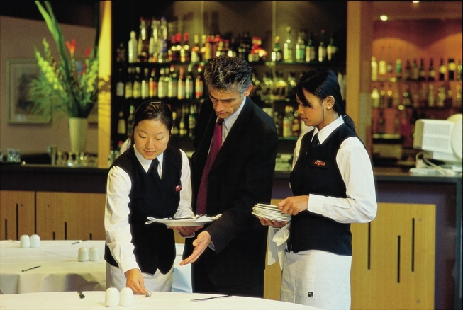
Staff performance appraisals forms
Staff appraisal format
The marking is aimed at what percentage of competency in a specific criteria.
As different staff within a department will have different skill levels, it focuses on what staff:
Can successfully do
What still needs to be achieved for full competency
Notes:
Class Activity –Questions
What marking system would you use to appraise staff?

Slide 132
Informing people of performance appraisals
What do the following people need to know?
Persons conducting assessment
Person who is being assessed
Venue where assessment is taking place
Notes:
Class Activity – Discuss
Prepare a list if the information each party should know

Slide 133

Informing people of performance appraisals
Methods to share assessment information
A formal letter
An information kit
A specific meeting
An email
An information session
Notes:
Class Activity – Discuss
Discuss the importance of each piece of information identified in the slide.
A formal letter - outlining the assessment process, dates and aims of assessment
An information kit – containing instructions, background information and a booklet of assessment questions for completing
A specific meeting – this may be for all staff members or with an individual person. This is normally used to explain the process to persons conducting the assessment
An email – quick and easy process to share information.
An information session – this may be for persons to be assessed, explaining them of the assessment requirements

Slide 134

Appraise staff performance
This is arguable the crux of the entire process where the staff member and management meet to discuss individual employee performance
The interview provides an opportunity for both parties to speak and provide comment and feedback
Notes:
Class Activity –Questions
What is involved in the process?

Slide 135

Appraise staff performance
People involved in staff appraisals
In determining who will appraise staff performance, the options are:
Supervisor
Customers
Self-appraisal – the employee themselves
Peer appraisal – using assessment centres
Subordinate appraisal
Notes:
Class Activity –Questions
Why would you include each of these?
What are the benefits of including these people?
If you were being appraised who would you like to do it and how many people would you like involved?

Slide 136

Performance appraisal format
Key steps involved in conducting a performance appraisal
Preparation
Employee to present their appraisal
Present your appraisal
Allow the employee to explain any differences and to vent any emotion
Recognise problems or reward performance
Notes:
Class Activity –Questions
What is involved in each step?
(Trainer to ask this question as an introduction. Each step will be discussed in more detail)

Slide 137

Staff appraisal action plan
Information for inclusion
Action Description
Approach
Resources Required
Mgt Assistance
Start Date
Completion Date
Review Date
Notes:
Class Activity –Question & Review
What information should be recorded in a staff appraisal action plan?
Refer to Section 5.4 of the Training Manual for an example of a staff appraisal action plan.

Slide 138

Staff appraisal outcomes
Types of staff appraisal outcome actions
In its most simple form a staff appraisal will identify two types of performance:
Performance which meets or exceeds standards and expectations
Performance which does not meet standards and expectations
The approach taken in response to these performances will vary depending on the severity of performance, either positive or negative.
Notes:
Class Activity –Questions
How would you handle these outcomes?

Slide 139
Staff appraisal outcomes
Performance which meets or exceeds standards and expectations
Recognition and Reward
Performance which does not meet standards and expectations
Guidance and Support
Coaching and Training
Formal Counselling
Disciplinary Action
Notes:
Class Activity –Questions
How would you handle these outcomes?

Slide 140

Coaching and training
Where staff performance is below requirements, one effective way of addressing this situation is to provide appropriate coaching or training.
To address staff performance deficiencies, you may elect to:
Provide on-the-job training
Mentor the staff
Coach the staff
Involve the employee in off-the-job training
Provide formal in-house training, off-the-job
Notes:
Class Activity –Questions
What on-the-job training programs exist or could be developed?
How can you mentor staff?
How can you coach staff?
What off-the-job training programs exist?

Slide 141
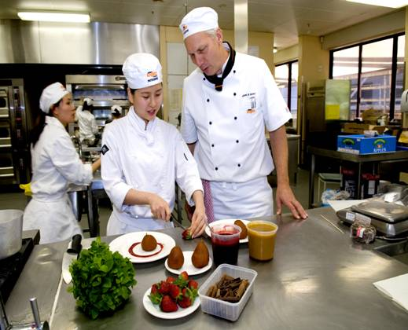
Follow up changes in the workplace
Regardless of the action chosen as a result of the performance appraisal, it is the role of the manager to follow up the performance of staff in the workplace to see:
If the desired changes have actually taken place
The current progress towards them
If the action plan is still relevant
Notes:
Class Activity – Questions
How can you follow up changes in the workplace?
Who should do this?
When should it be done?

Slide 142
Follow up changes in the workplace
Following up
Obviously the follow-up will depend on what was originally contained in the action plan.
The two basic follow-up actions are:
Checking that what was promised is happening
Taking action to make sure things happen as planned
Notes:
Class Activity – Discussion.
Discuss the importance of following up.

Slide 143

Follow up changes in the workplace
Methods to follow up changes
A manager can:
Observe the staff member in the workplace
Talk to customers
Speak with other supervisors
Discuss directly with the employee
Notes:
Class Activity – Questions
Which is the best method?
When is it best to use each method?

Slide 144
Follow up changes in the workplace
Follow up requirements
You may be required to:
Confirm training has been delivered as scheduled
Confirm the employee has attended and is participating actively in training
Confirm staff who have been allocated coaching tasks are doing what they have been asked to do
Confirm promised resources have been provided
Notes:
Class Activity – Discussion.
Discuss the importance of each follow up requirement.
Why would these requirements be necessary?

Slide 145

Follow up changes in the workplace
Follow up requirements
Re-write the action plan
Schedule another appraisal interview at an earlier time
Extend timelines originally agreed on
Include new tasks for the staff member as need dictate
‘Sign off’ on activities as they are completed
Meet with others (co-workers, customers, other supervisors) to get feedback on the progress of the employee
Notes:
Class Activity – Discussion.
Discuss the importance of each follow up requirement.
Why would these requirements be necessary?

Slide 146
Follow up changes in the workplace
Conducting a review with the staff member
At the pre-arranged date and time the review of the employee’s performance should take place.
Points to ensure include:
Provide the employee with sufficient notice of the session
Prepare the venue for the review
Obtain objective evidence regarding current employee performance
Notes:
Class Activity – Questions
Why is a review with the staff member important?
When is it best done?
What information would you like at your disposal when conducting a performance follow up review with staff?

Slide 147

Follow up changes in the workplace
Conducting a review with the staff member
Allow the employee to comment on their opinion of:
How their work has changed
How effective the support provided by the employer has been
What they think needs to be done into the future
Give your opinion
Record the review session
Notes:
Class Activity – Questions
Why is it important for both management and staff to have the opportunity to comment?

Slide 148

Element 6:
Provide for human resource development
Notes:
Introduce topic.
Class Activity – General Discussion
Ask general questions:
How do you know when training and development is required?
What are training and development opportunities that may be given to staff?

Slide 149
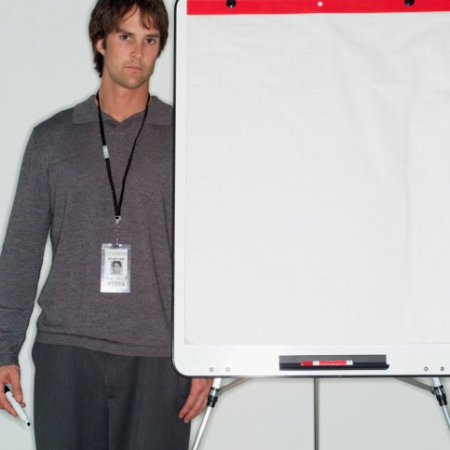
Provide for human resource development
Performance Criteria for this Element are:
Identify training and development activities and opportunities for staff
Provide and resource training and development activities and opportunities for staff
Monitor the progress and effectiveness of human resource development that has been provided
Notes:
Trainer identifies the Performance Criteria for this Element, as listed on the slide.

Slide 150

Professional development opportunities
One of the key characteristics of successful teams is the ability to recognise and provide training and development opportunities to staff:
What training and development opportunities exist?
Notes:
Discussion
What are the benefits of providing these for:
Owners
Managers
Staff members themselves
Customers

Slide 151

Professional development opportunities
Developing the ‘skill set’
All team members must have the opportunity to improve their ‘skill set’ which aims at the development of:
Knowledge
Skills
Attitudes
Notes:
Discussion
Trainer to discuss the difference between these
Identify examples of different training sessions and how each of these points are developed
What is the best way to ‘develop’ each of these points?

Slide 152

Professional development opportunities
Staff training and staff development
Staff training will be applied to address a need that has some immediacy to it
Staff development has more of a future orientation and relates to skills and knowledge the staff member may need at some future date
Notes:
Discussion
What are the benefits of each of these approaches?
What are examples of development programs for each of these?

Slide 153

Professional development opportunities
Professional development
Staff development is often referred to in another name: ‘Professional development’:
What are examples of ‘professional development’ activities?
How do you select people?
Notes:
Discussion
Discuss the questions in the slide.

Slide 154

Professional development opportunities
Types of professional development opportunities
Internal training and professional development
External training and professional development
Coaching
Mentoring
Supervision
Formal and/or informal learning programs
Notes:
Discussion
Identify each type of professional development opportunity?
When would it be beneficial?

Slide 155

Professional development opportunities
Types of professional development opportunities
Work experience and exchange opportunities
Personal study
Career planning and development
Performance appraisals
Workplace skills assessment
Quality assurance assessments and recommendations
Change in job responsibilities
Notes:
Discussion
Identify each type of professional development opportunity?
When would it be beneficial?

Slide 156

Professional development opportunities
Types of professional development opportunities
Opportunity for greater autonomy or responsibility
Formal promotion
Chance to perform in a higher position in a caretaker mode
Becoming a mentor for someone
Leading a training session
Being sent to a conference
Notes:
Discussion
Identify each type of professional development opportunity?
When would it be beneficial?

Slide 157

Mentoring
It is a relationship between two people where a more experienced person works in collaboration with a less experienced person to give the less experienced person the benefit of their:
Knowledge
Experience
Perspective
Contacts
Insight
Wisdom
Notes:
Discussion
Why is mentoring such a popular professional development activity?
What are the benefits?
How long should the mentoring process last?

Slide 158
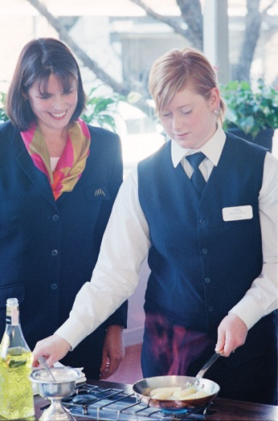
Coaching
This is where you deliver on-the-job training to individuals and groups using a wide range of training options:
What training options exist?
Notes:
Discussion
Discuss the question in the slide.

Slide 159
Coaching
Coaching options
Demonstrations
Discussion
Lectures
Case studies
Role-plays
Games
Notes:
Discussion
Discuss the different coaching options as identified in this slide.

Slide 160

Coaching
Coaching options
Exercises
Excursions
Guest speakers
Presentations
Providing explanations
Problem-solving
Notes:
Discussion
Discuss the different coaching options as identified in this slide.

Slide 161
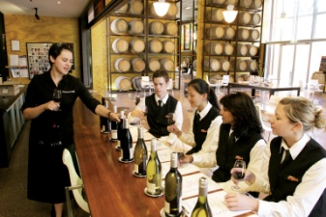
Formal and informal learning programs
Formal learning
An externally provided course
An internal non-accredited training course
Informal learning
Less structured programs
Greater flexibility
As required
Notes:
Discussion
What is the different between these two approaches?
What are the benefits of each?
What are examples of formal and informal learning programs?

Slide 162

Other development programs
Other professional development programs
Personal study
Work experience
Job rotation
Notes:
Discussion
What are these approaches?
What are the benefits of each?

Slide 163

Provide resources for development and training
Types of resources
Time
Space/location and venues
Trainers
Financial resources
Support materials
Equipment and consumables
Items required to support training practice
Notes:
Discussion
Why are these resources important?

Slide 164

Monitor development of staff
Types of resources
Why is it important to monitor the performance of staff?
What actual aspects of performance do you want to monitor?
How do you do it?
Notes:
Discussion
Discuss the questions in the slide.

Slide 165
Monitor development of staff
You need to monitor workplace performance of staff to:
Identify those who need help
Help determine whether actual outcomes are person-based or related to other issues
Identify good performance
Identify staff who may be suitable for promotion
Remind staff their performance at work is under scrutiny
Notes:
Discussion
Discuss the importance of these points.

Slide 166

Element 7:
Evaluate the implementation of the human resource plan
Notes:
Introduce topic.
Class Activity – General Discussion
Ask general questions:
What do you need to evaluate in relation to Human Resources activities?

Slide 167

Evaluate the implementation of the human resource plan
Performance Criteria for this Element are:
Use suitable methods to evaluate the effectiveness of the human resource plan
Assess the extent to which the objectives of the human resource plan have been achieved
Review external and internal factors that have impacted human resource performance
Review and evaluate human resource policies and procedures
Notes:
Trainer identifies the Performance Criteria for this Element, as listed on the slide.

Slide 168

Evaluate the implementation of the human resource plan
Performance Criteria for this Element are:
Review and evaluate the organization of human resources
Review and evaluate the supervision, leadership and motivation of staff
Review and evaluate staff performance appraisal system
Review and evaluate the provision of human resource development
Recommend strategies to maintain or improve human resource outcomes
Notes:
Trainer identifies the Performance Criteria for this Element, as listed on the slide.

Slide 169
Evaluate human resources plan
Methods to evaluate human resources plan
Statistical analysis of costs, trade, revenue, materials used and other key indicators
Interviews with and surveys of stakeholders, including staff and management and which may include the use of focus groups
Solicited and unsolicited feedback
Organizational reviews
Workforce management data with an emphasis on staffing levels and labour cost figures
Notes:
Class Activity – Explanation
Discuss these methods.
What are their purposes?

Slide 170
Evaluate human resources plan
Quantitative and qualitative analysis compares ‘hard’ data with ‘soft’ data considering:
Levels of absenteeism against different staffing levels
Level of staff departing the organisation
Complaints matched against staffing levels
Wastage
Damage
Notes:
Class Activity – Explanation
What other data would you like to know?

Slide 171

Evaluate human resources plan
‘Benchmarking’
Identifying best practices and comparing them to what happens in the workplace:
What would you like to ‘benchmark’?
Notes:
Class Activity – Discussion
Discuss the question in the slide.

Slide 172

Review achievement of human resources objectives
On a regular basis it is important to see if the Human Resources effort has successfully reached the objectives it was trying to achieve:
Review the objectives
Identify progress towards achieving objectives
Identify differences
Provide reasons for differences
Amend objectives and strategies
Notes:
Class Activity – Explanation
Discuss these steps

Slide 173

Review external and internal factors
Importance of regular reviews
It is vital that this evaluation process is conducted on a regular basis to ensure that the factors and their likely impact is as accurate as possible:
How can you review external factors?
How can you review external factors?
Notes:
Class Activity – Discussion
Discuss the questions in the slide.

Slide 174

Review human resources policies and procedures
Method to review policies and procedures
Revisit objectives
Review objectives
Identify problems or concerns
Review policies and procedures
Identify changes required to policies and procedures
Monitor new or amended policies and procedures
Conduct follow up evaluations
Notes:
Class Activity – Discussion
What are the benefits of conducting this review?
Who should be involved?

Slide 175

Review human resources department
Importance of evaluating human resources department
Identify the HR programs that are most important to achieving your organization's objectives
Find out how well the HR department is delivering those programs
Benchmark the HR work to ensure continuous improvement
Promote change and creativity
Focus the HR staff on important issues
Bring HR closer to the line functions of the hospitality establishment
Notes:
Class Activity – Discussion
What should be reviewed?
How can this be done?
Who should do it?

Slide 176

Review and evaluate management
Management appraisal format
Managers are traditionally employed to meet key objectives leading to operational and organisational success
They are many areas in which management must have an acceptable level of expertise
The marketing criteria is different to that contained within a staff appraisal form, as it is expected managers are employed with the necessary knowledge, skills and attributes to conduct management activities
Notes:
Class Activity –Questions
What marking system would you use to appraise managers?

Slide 177

Review and evaluate management
Areas included in a management appraisal include:
Managers work accomplishments
Major business objectives
Personal growth objectives
Appraisal of different performance indicators
Notes:
Class Activity –Review management performance appraisals
Look and discuss example of management performance appraisal in Section 3.1 of the Training Manual.
Trainer also to collect, distribute and discuss performance appraisals used in different hospitality organisations.

Slide 178
Review performance appraisal system
Steps to evaluate an appraisal system
Determine compliance of appraisal system
Determine effectiveness of appraisal system
Determine accuracy of appraisal system
Determine benefits of appraisal system
Notes:
Class Activity –Discussion
Discuss the importance of these points.

Slide 179

Review development programs
Evaluate the impact of training and development programs may include:
Seeking input from all relevant stakeholders
Comparing pre-training event workplace practice, operation, statistics with post-training event workplace practice, operation, statistics
Focusing on the criteria that were identified as being central to evaluating participation
Comparing the outcomes of training events with standard programs
Notes:
Class Activity – Questions
Why is this important?

Slide 180

Assess value for money of training
Planning and implementing events does not come cheap and every manager wants to get a return on the investment they have made:
How can you assess value for money?
Notes:
Class Activity – Questions
Discuss the question in the slide.

Slide 181

Assess value for money of training
Tracking the costs
Staff wages in relation to those who attended training and assessment sessions
Consumables
Purchases and hiring charges
Accommodation, travel and meals
Notes:
Class Activity – Questions
Who needs to be paid wages?
What consumables are there?
What is normally purchased?
What is normally hired?
What other costs are associated with training events?

Slide 182

Assess value for money of training
Determining value
Increasing revenue
Offering greater levels of service
Developing staff
Reducing accidents
Reducing labour costs
Notes:
Class Activity – Questions
Why is it hard to determine value?

Slide 183

Assess value for money of training
Determining value
Improving efficiency
Reducing complaints
Increasing consistency in service
Increasing customer satisfaction
Strengthening brand value
Notes:
Class Activity – Questions
What are other types of value?

Slide 184

Assess value for money of training
Assessing value for money
Undertaking a cost-benefit analysis, including identification and quantification of hidden costs
Comparing pre-engagement cost-benefit analysis figures with post-participation cost-benefit analysis,
Identifying alternative training that could have been provided at the same actual cost
Obtaining positive and/or negative emotional issues experienced by learners
Notes:
Class Activity – Questions
Discuss these methods to assess value for money

Slide 185

Recommend strategies to improve human resources
Importance of reports
May be reported in a formal or informal manner
The precise method used in each instance will depend on the particular establishment’s policies and procedures
Notes:
Class Activity – Questions
What types of reports are prepared particularly focused on the improvement of human resources?
What should the content of reports include?
Who prepares these reports?
Who receives these reports?

Slide 186

Recommend strategies to improve human resources
Contents of a report
An outline and overview of the training events that were used
Identification of the costs involved and benefits that resulted
Identification of numbers of staff who engaged with training events
An overview of learners’ evaluations of participation in training events
Comparative cost analysis of providing leaner training using alternative means
Description of up-coming training events
Notes:
Class Activity – Questions
What other information could be included in reports?

Slide 187
Recommend strategies to improve human resources
Contents of a report
Summary of performance appraisal programs
Summary of employment and retention records
Summary of injuries and accidents
Suggestions for staff development initiatives
Notes:
Class Activity – Questions
What other information could be included in reports?

Slide 188

Recommend strategies to improve human resources
Who might receive a report?
Management and/or the owners of the business
The HR department
Head office
The supervisor in the area where the learner works
Notes:
Class Activity – Questions
What information do these specific people need?

Slide 189

Recommend strategies to improve human resources
Why are these reports required?
Checking overall skill levels of staff
Identifying those who appear appropriate for future skill development
Providing a reference for promoting employees
Amending employee’s staffing record
Compiling statistical records
Notes:
Class Activity – Questions
Discuss importance
Thank the audience and deliver assessments as required.

